Slide 1
Trading card database
Peter Leung – CSCI 440: Systems programming

Slide 2
What is it?
Database of trading cards
i.e. baseball, football, etc.
Contains a table of all cards in the database along with attributes
In this case, a baseball card collection was created
database objects:
Tradingcardsdb database file
Baseballcards table
Contains individual entries that represent baseball cards
Additional tables can be created to store user lists

Slide 3
Real world use
Envisioned use for various types of groups
A Hobby card store that needs to store inventory of valuable cards
A group of friends that need to keep track of what they have for trading
An online forum group that is planning to meet up at an event (i.e. convention)
To plan out what to bring for trading
To see what to ask others to bring for trading

Slide 4
Built in WAMP
Three-tier application structure
Database Tier – MySQL
Application tier – apache server
Application tier – php program
Client tier – web browser (i.e. google chrome)
Thin client: user should only interact through a browser
Although the db administrator should have access through wamp (phpmyadmin)

Slide 5
Benefits of three-tier applications
New modules of code can be written/added to build the application
Modular, expandable
Client needs only to focus on what is on the browser
Client does not need to download any additional software
Essentially allows a user to perform limited functions to a mysql db without extensive knowledge

Slide 6
Php application
Program is utilized for oltp
Essentially a web-app that interacts with the database on the server
Functions:
Add a card
Delete a card
View all cards
Look up Card Information
Lists

Slide 7
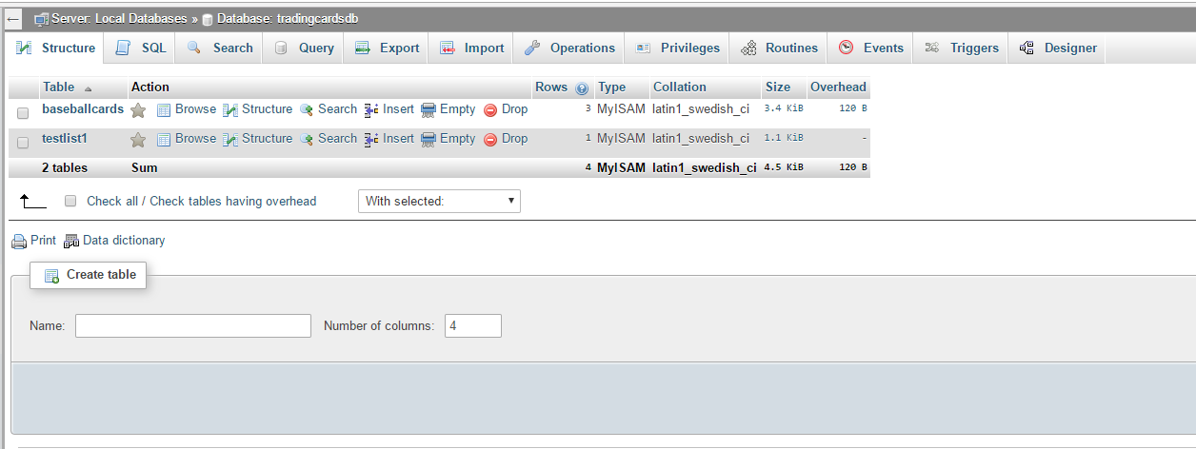
Database Structure Created with phpMyAdmin

Slide 8
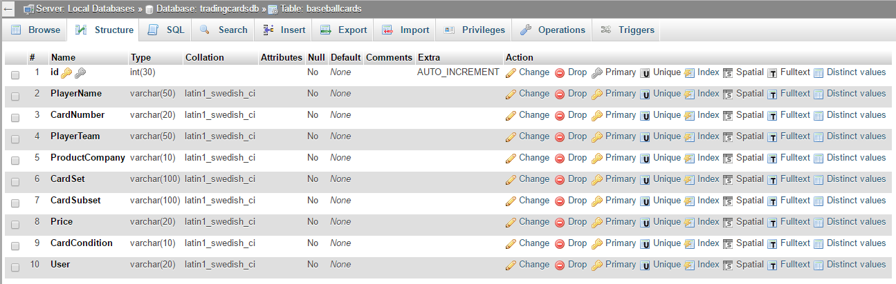
Baseballcards Table Structure

Slide 9
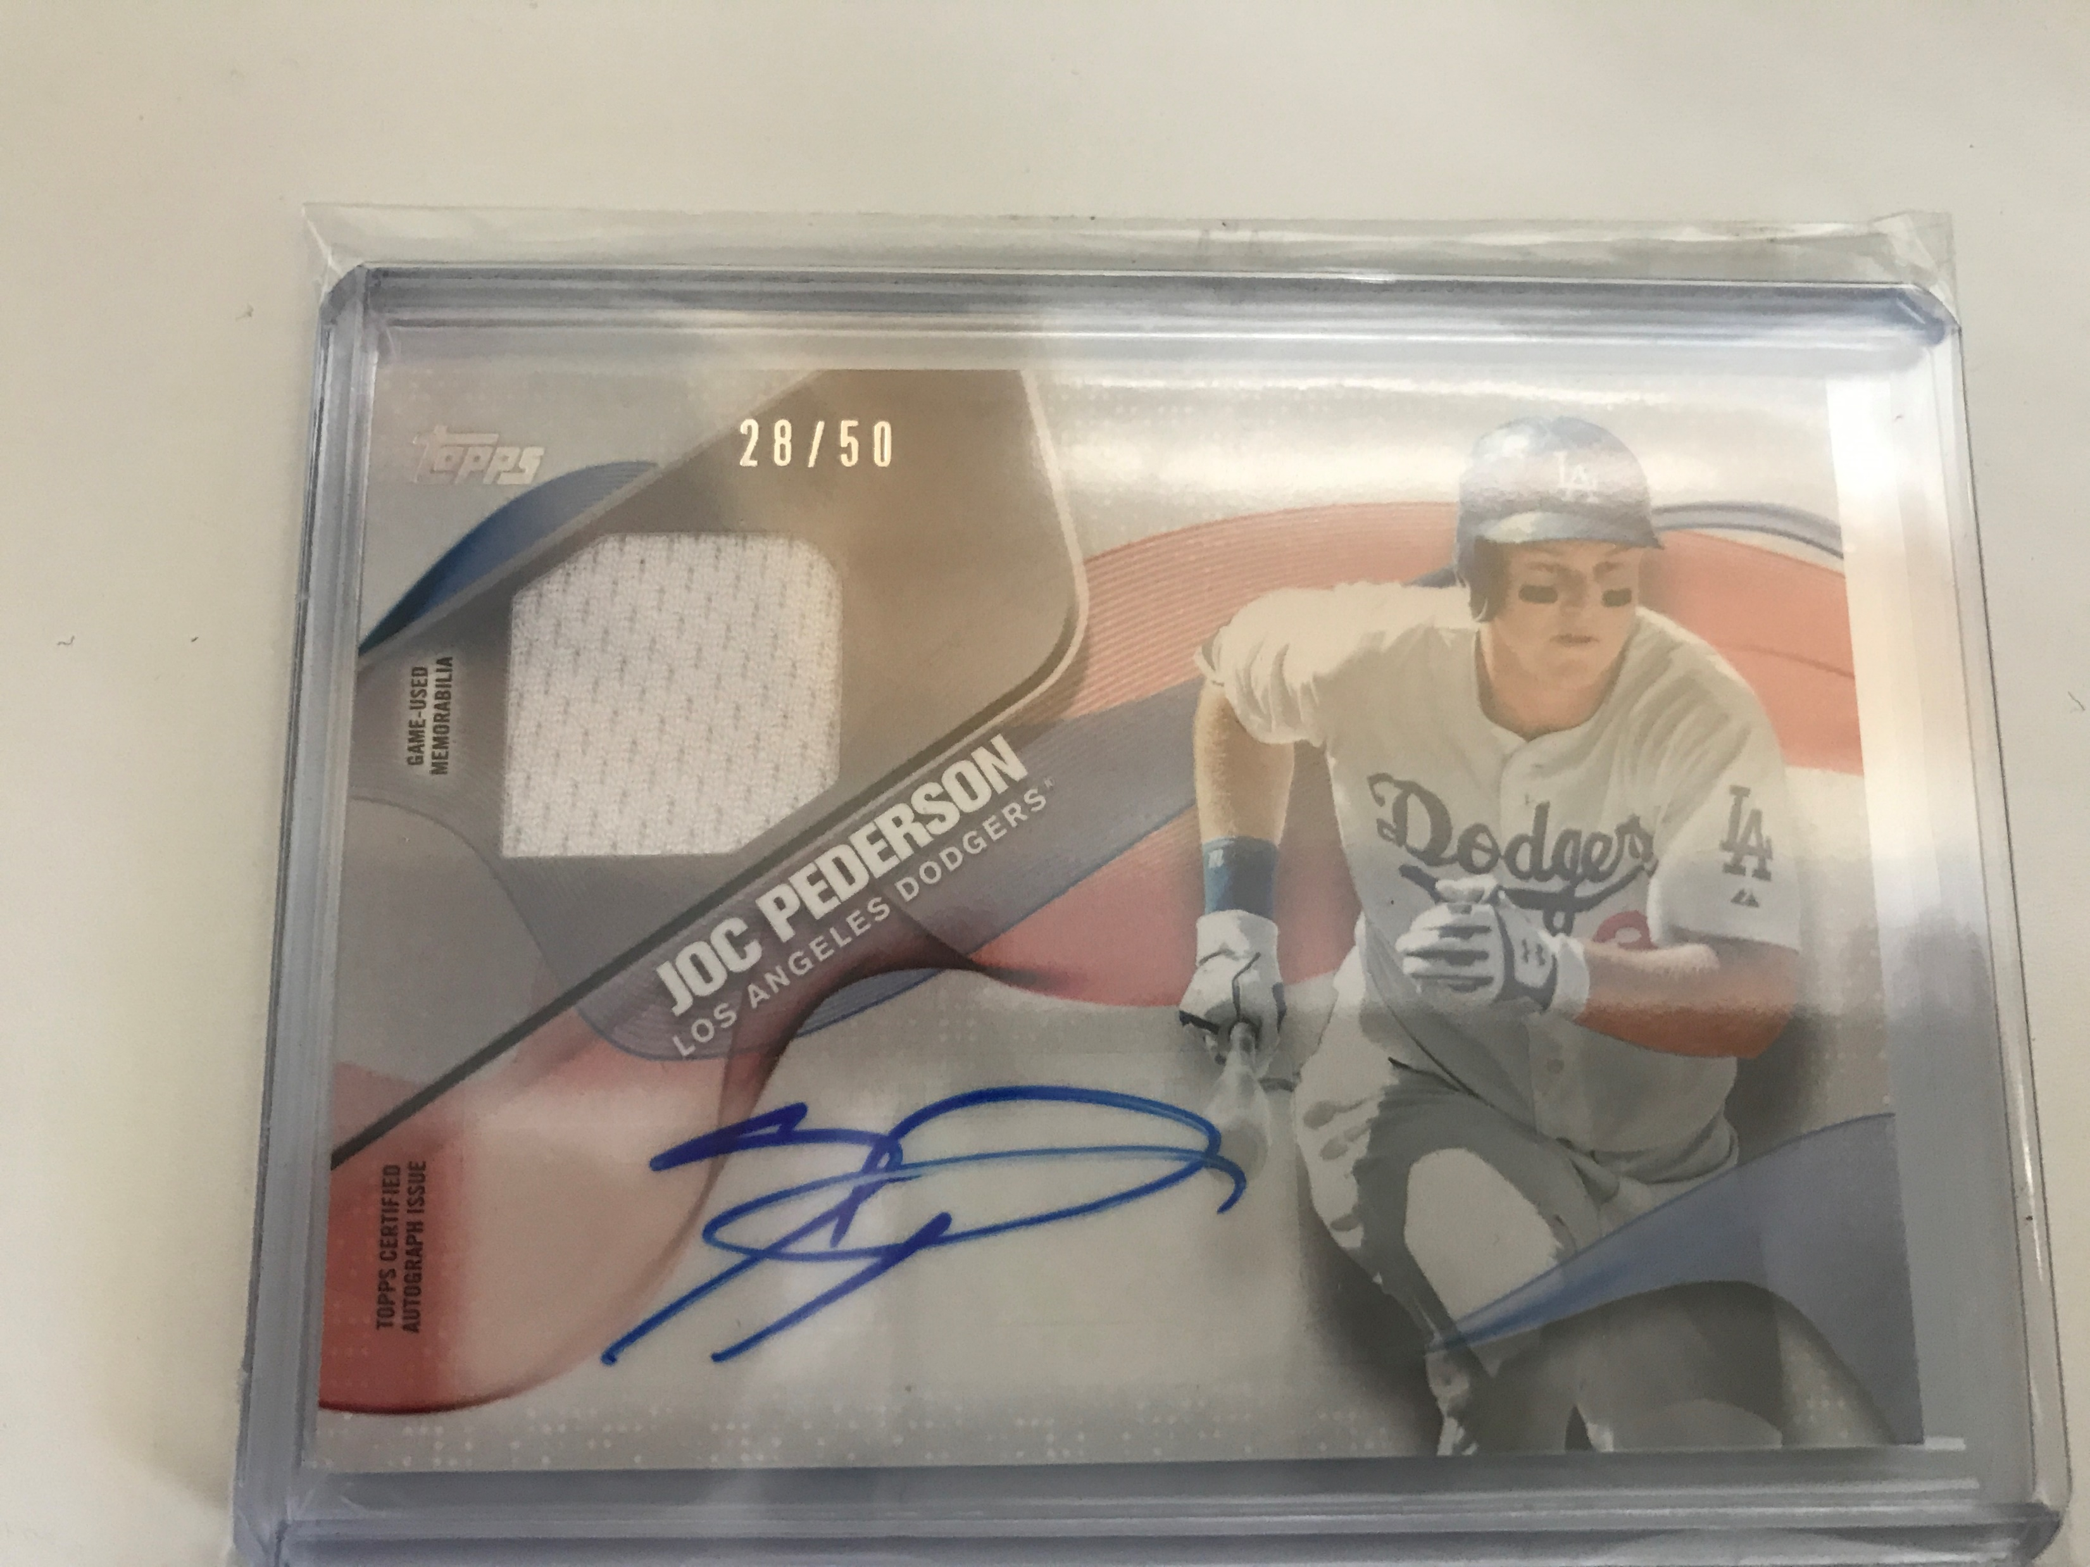
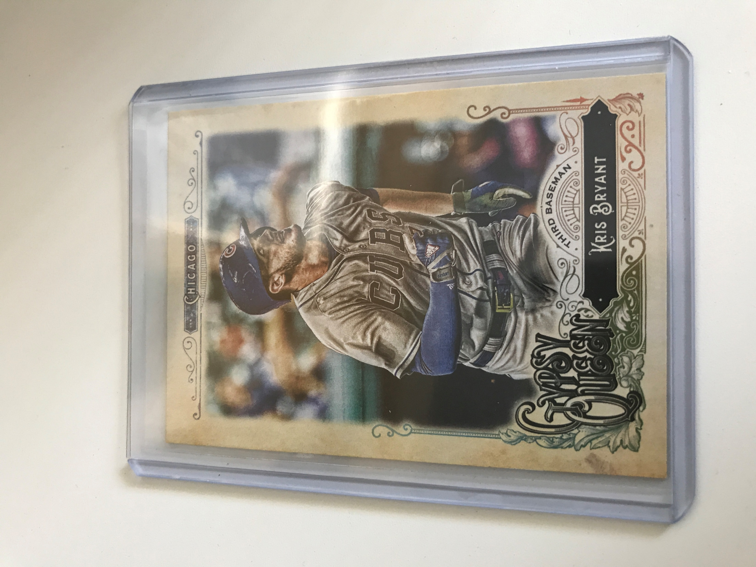
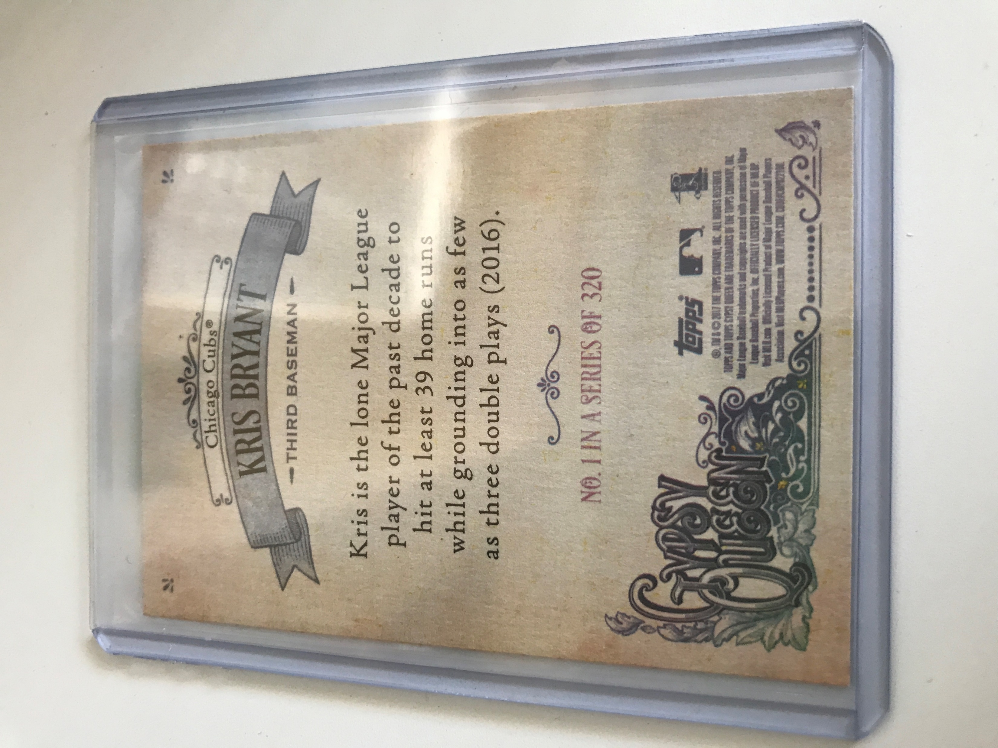
Sample cards

Slide 10
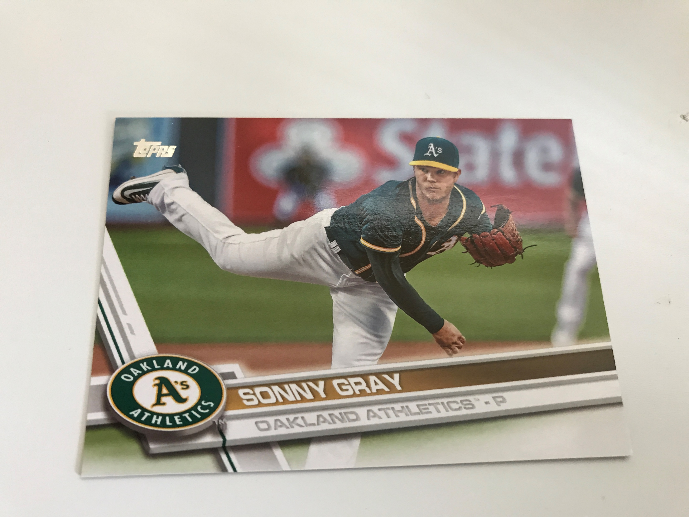
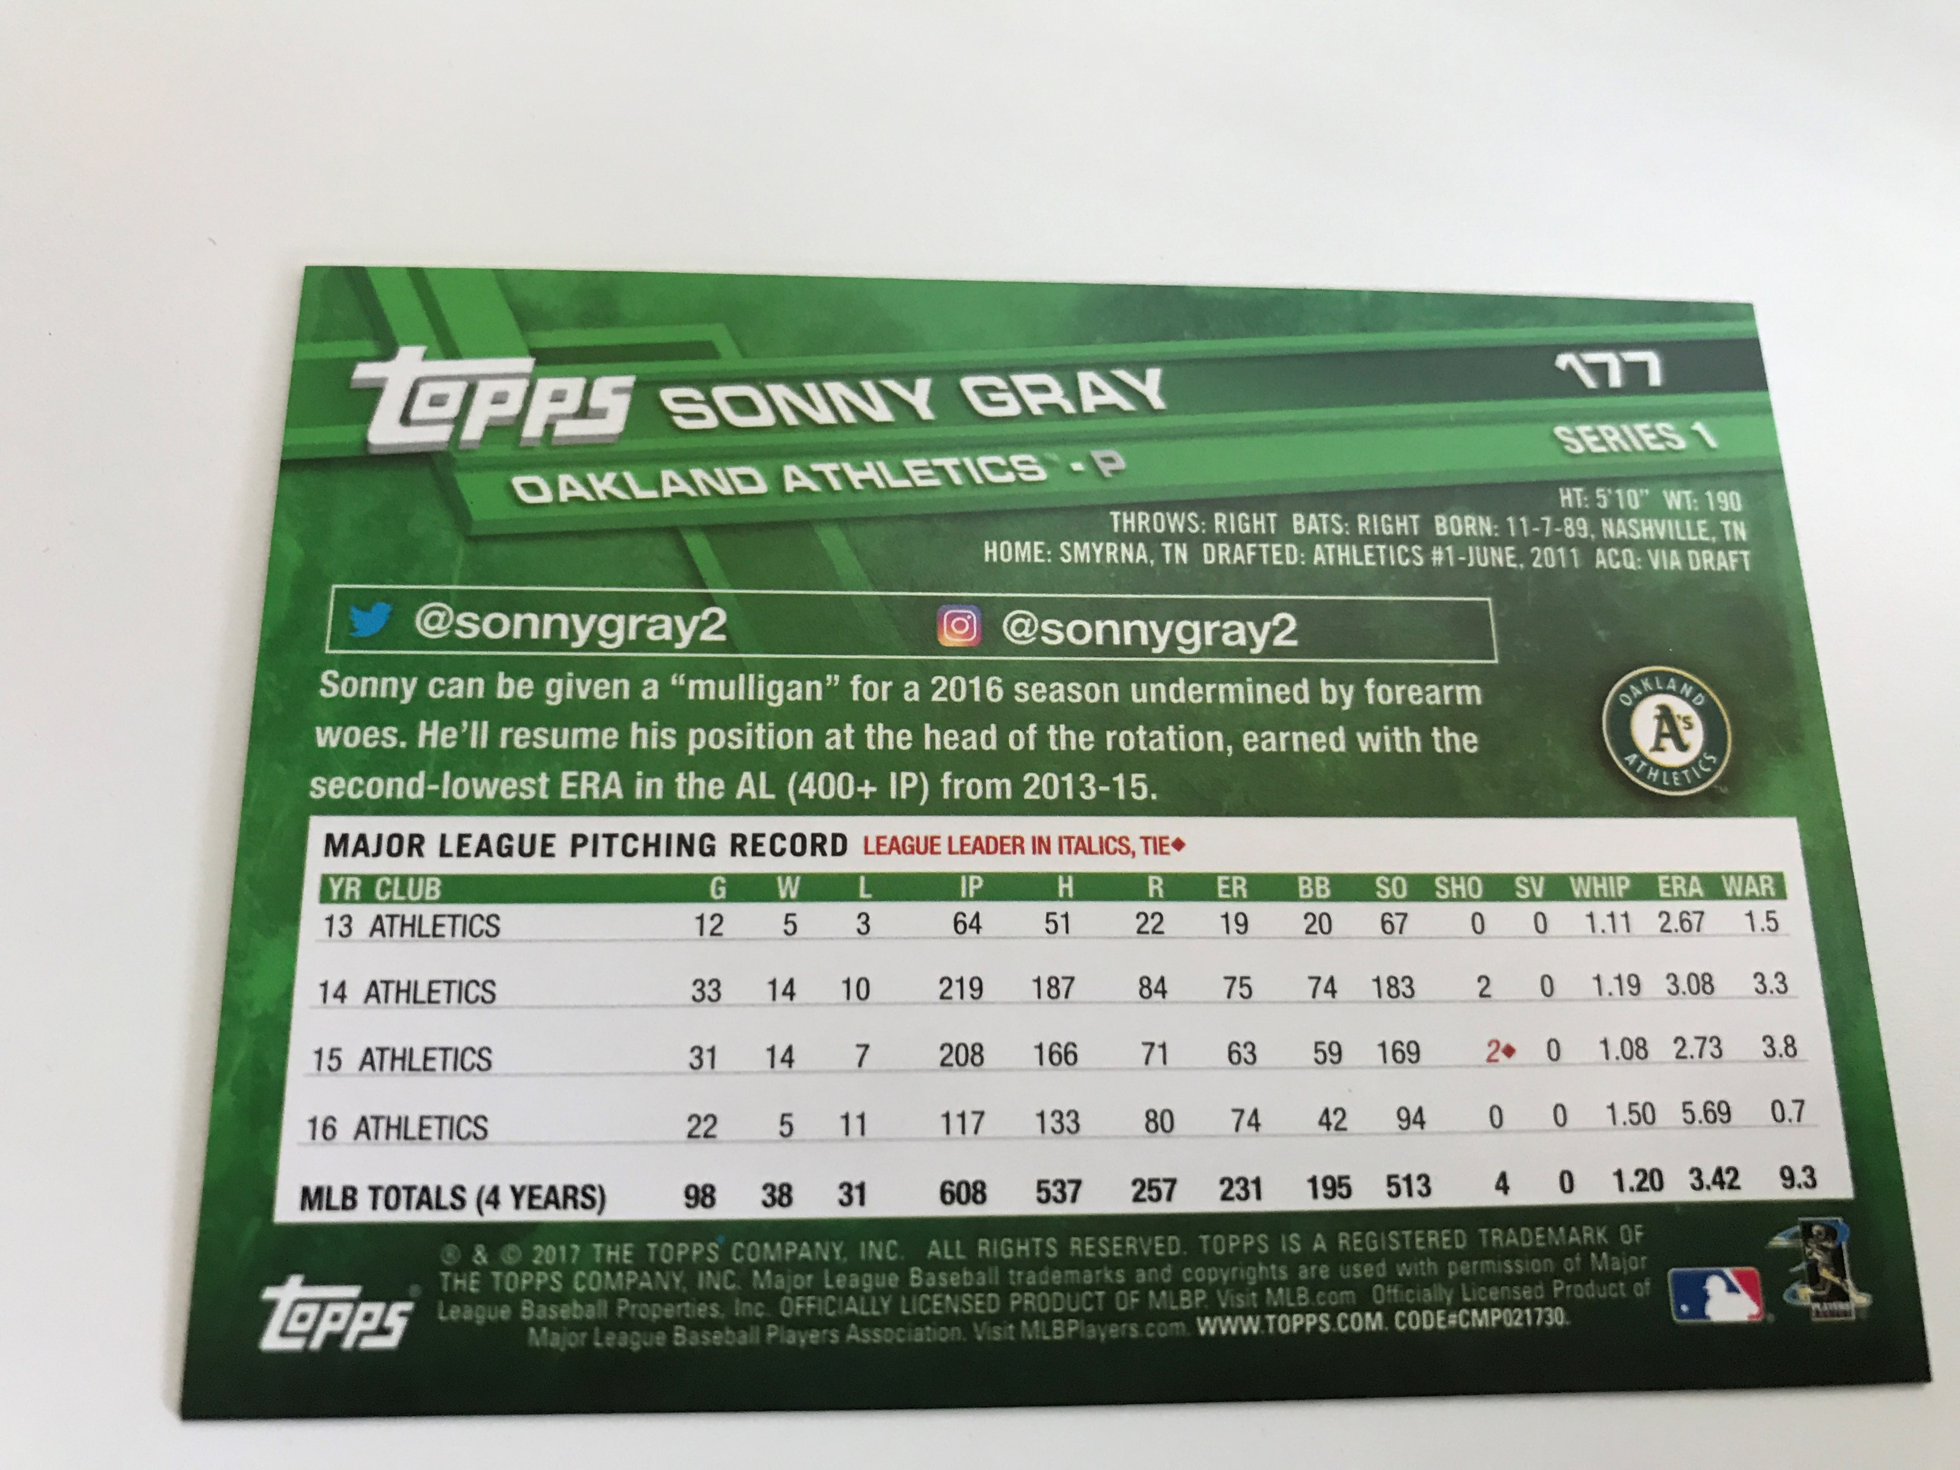
Sample Cards, cont.

Slide 11
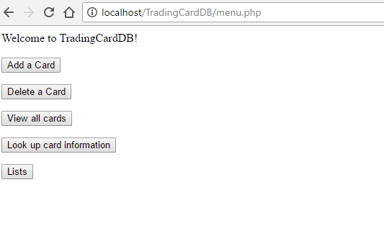
menu.php

Slide 12
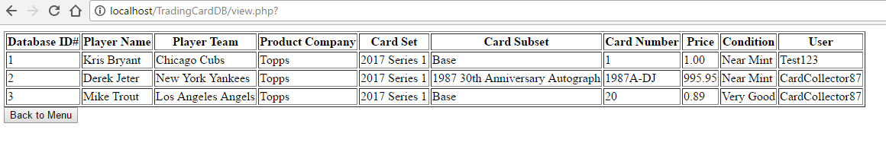
view.php

Slide 13
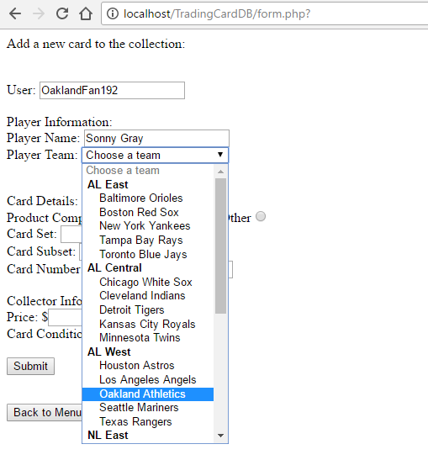
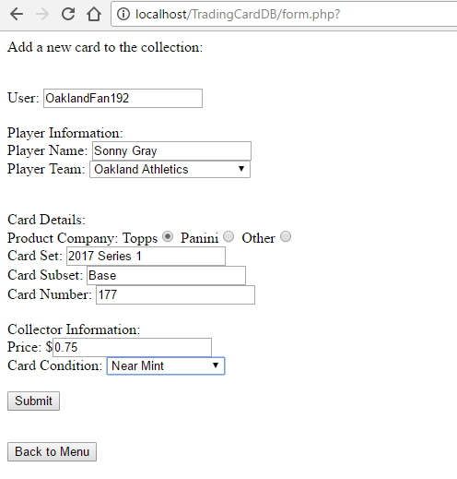
Adding a card with form.php

Slide 14
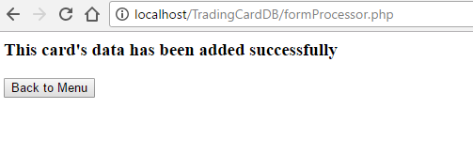
Add successful!
Clicking submit sends the request to formprocessor.php, which adds the card to the db and table using a sql query

Slide 15
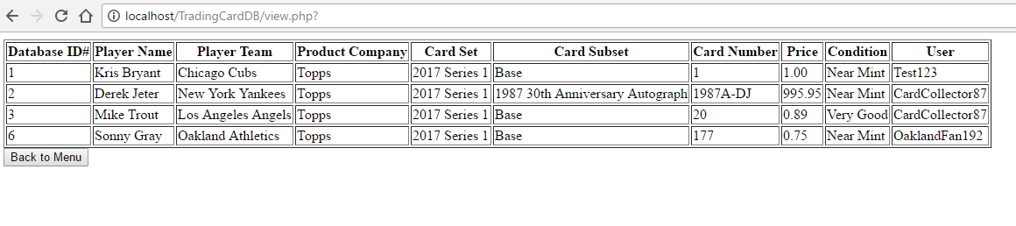
results

Slide 16
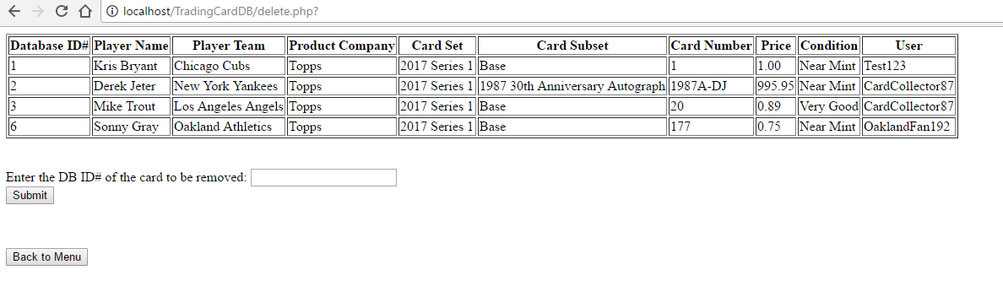
Delete.php

Slide 17
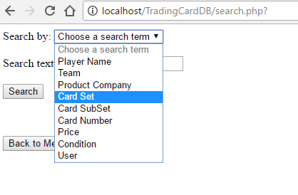
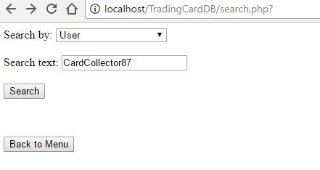
Search.php
If we click on “look up card information” in the menu…

Slide 18
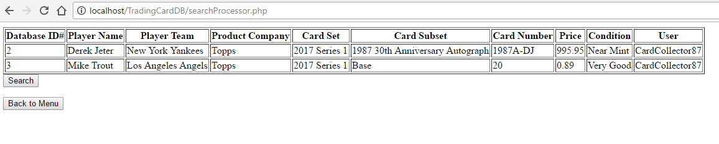
Search Results
“Submit” sends the request to searchprocessor.php, which performs a query to find items based on search parameters

Slide 19
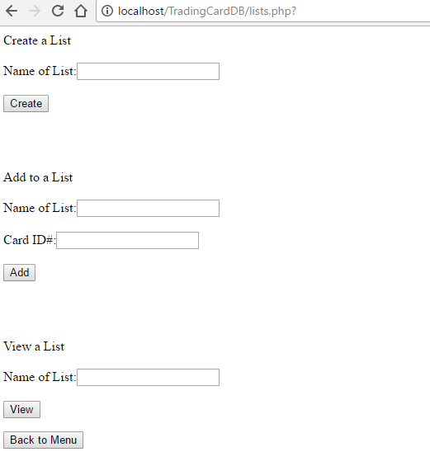
Lists

Slide 20
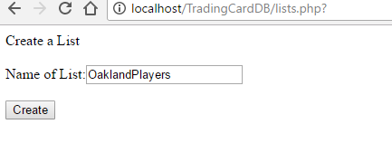
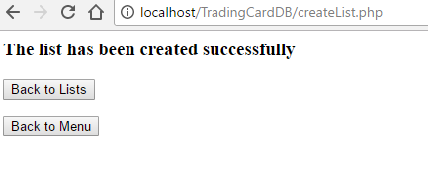
Make a list

Slide 21
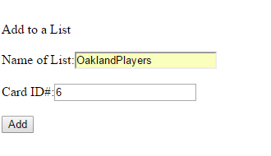
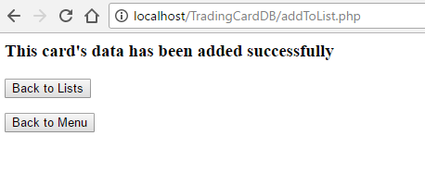
Add to a list

Slide 22
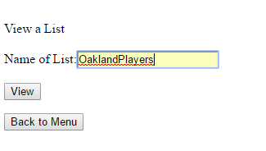
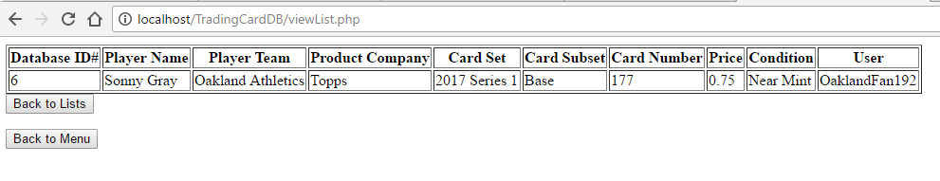
View a list

Slide 23
Possible Future improvements
Cookies: to keep track of users
Passwords: to allow users access over only their lists
Store references to pictures in each card entry
Link to a picture on the web
Link to a picture stored on the filesystem
Create a more robust search engine
“smart” set/subset select options
Drop-down menus for sets that automatically limit subset selections

Slide 24
Thank you for your time!

